Slide 2
Notes:
Teacher notes
In ‘Slide Show’ mode, click the name of a section to jump straight to that slide.

Slide 3
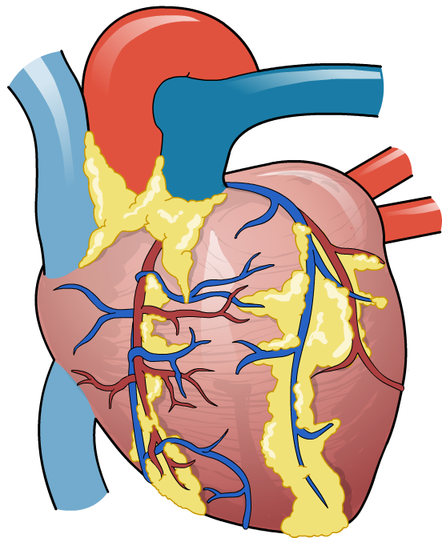

The human heart
The heart is a muscular organ located between the lungs in the centre of the chest (thorax), and is about the size of a fist.
It pumps blood continuously around the body. An organism can lose consciousness within just a few seconds if the brain is deprived of blood.
In foetuses, the heart begins beating about 5–6 weeks after conception.
Notes:
foetus
英
/ˈfiːtəs/
美
/ˈfitəs/
n. 胎儿

Slide 4

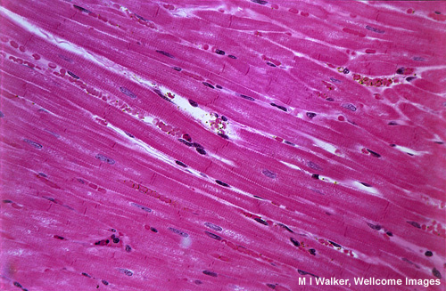
Cardiac muscle
The heart mainly consists of cardiac muscle心肌 tissue, which like smooth muscle (but not skeletal muscle), contracts involuntarily.
Cardiac muscle is made up of cells that are connected by cytoplasmic bridges. This enables electrical impulses to pass through the tissue.
It contains large numbers of mitochondria and myoglobin肌红蛋白 molecules.

Slide 5
main functions of the heart:
to pump blood throughout the body.
Blood delivers oxygen, hormones, glucose and other components to various parts of the body, including the human heart.
The heart also ensures that adequate blood pressure is maintained in the body

Slide 6

Structure of the heart

Slide 7
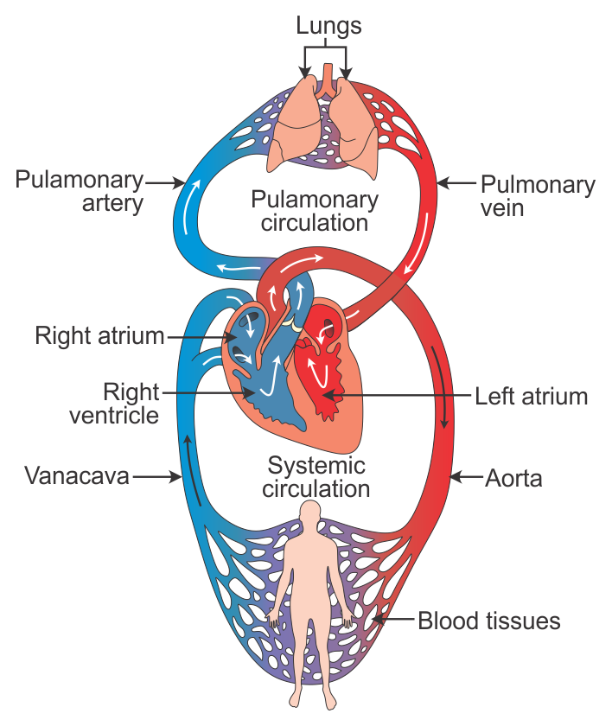
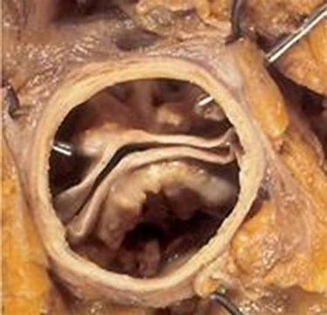
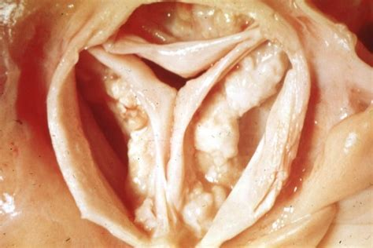
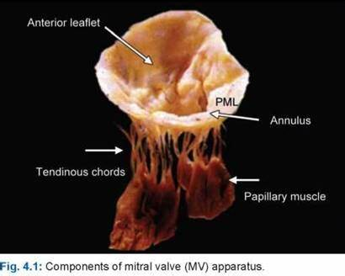
bicuspid
tricuspid

Slide 8
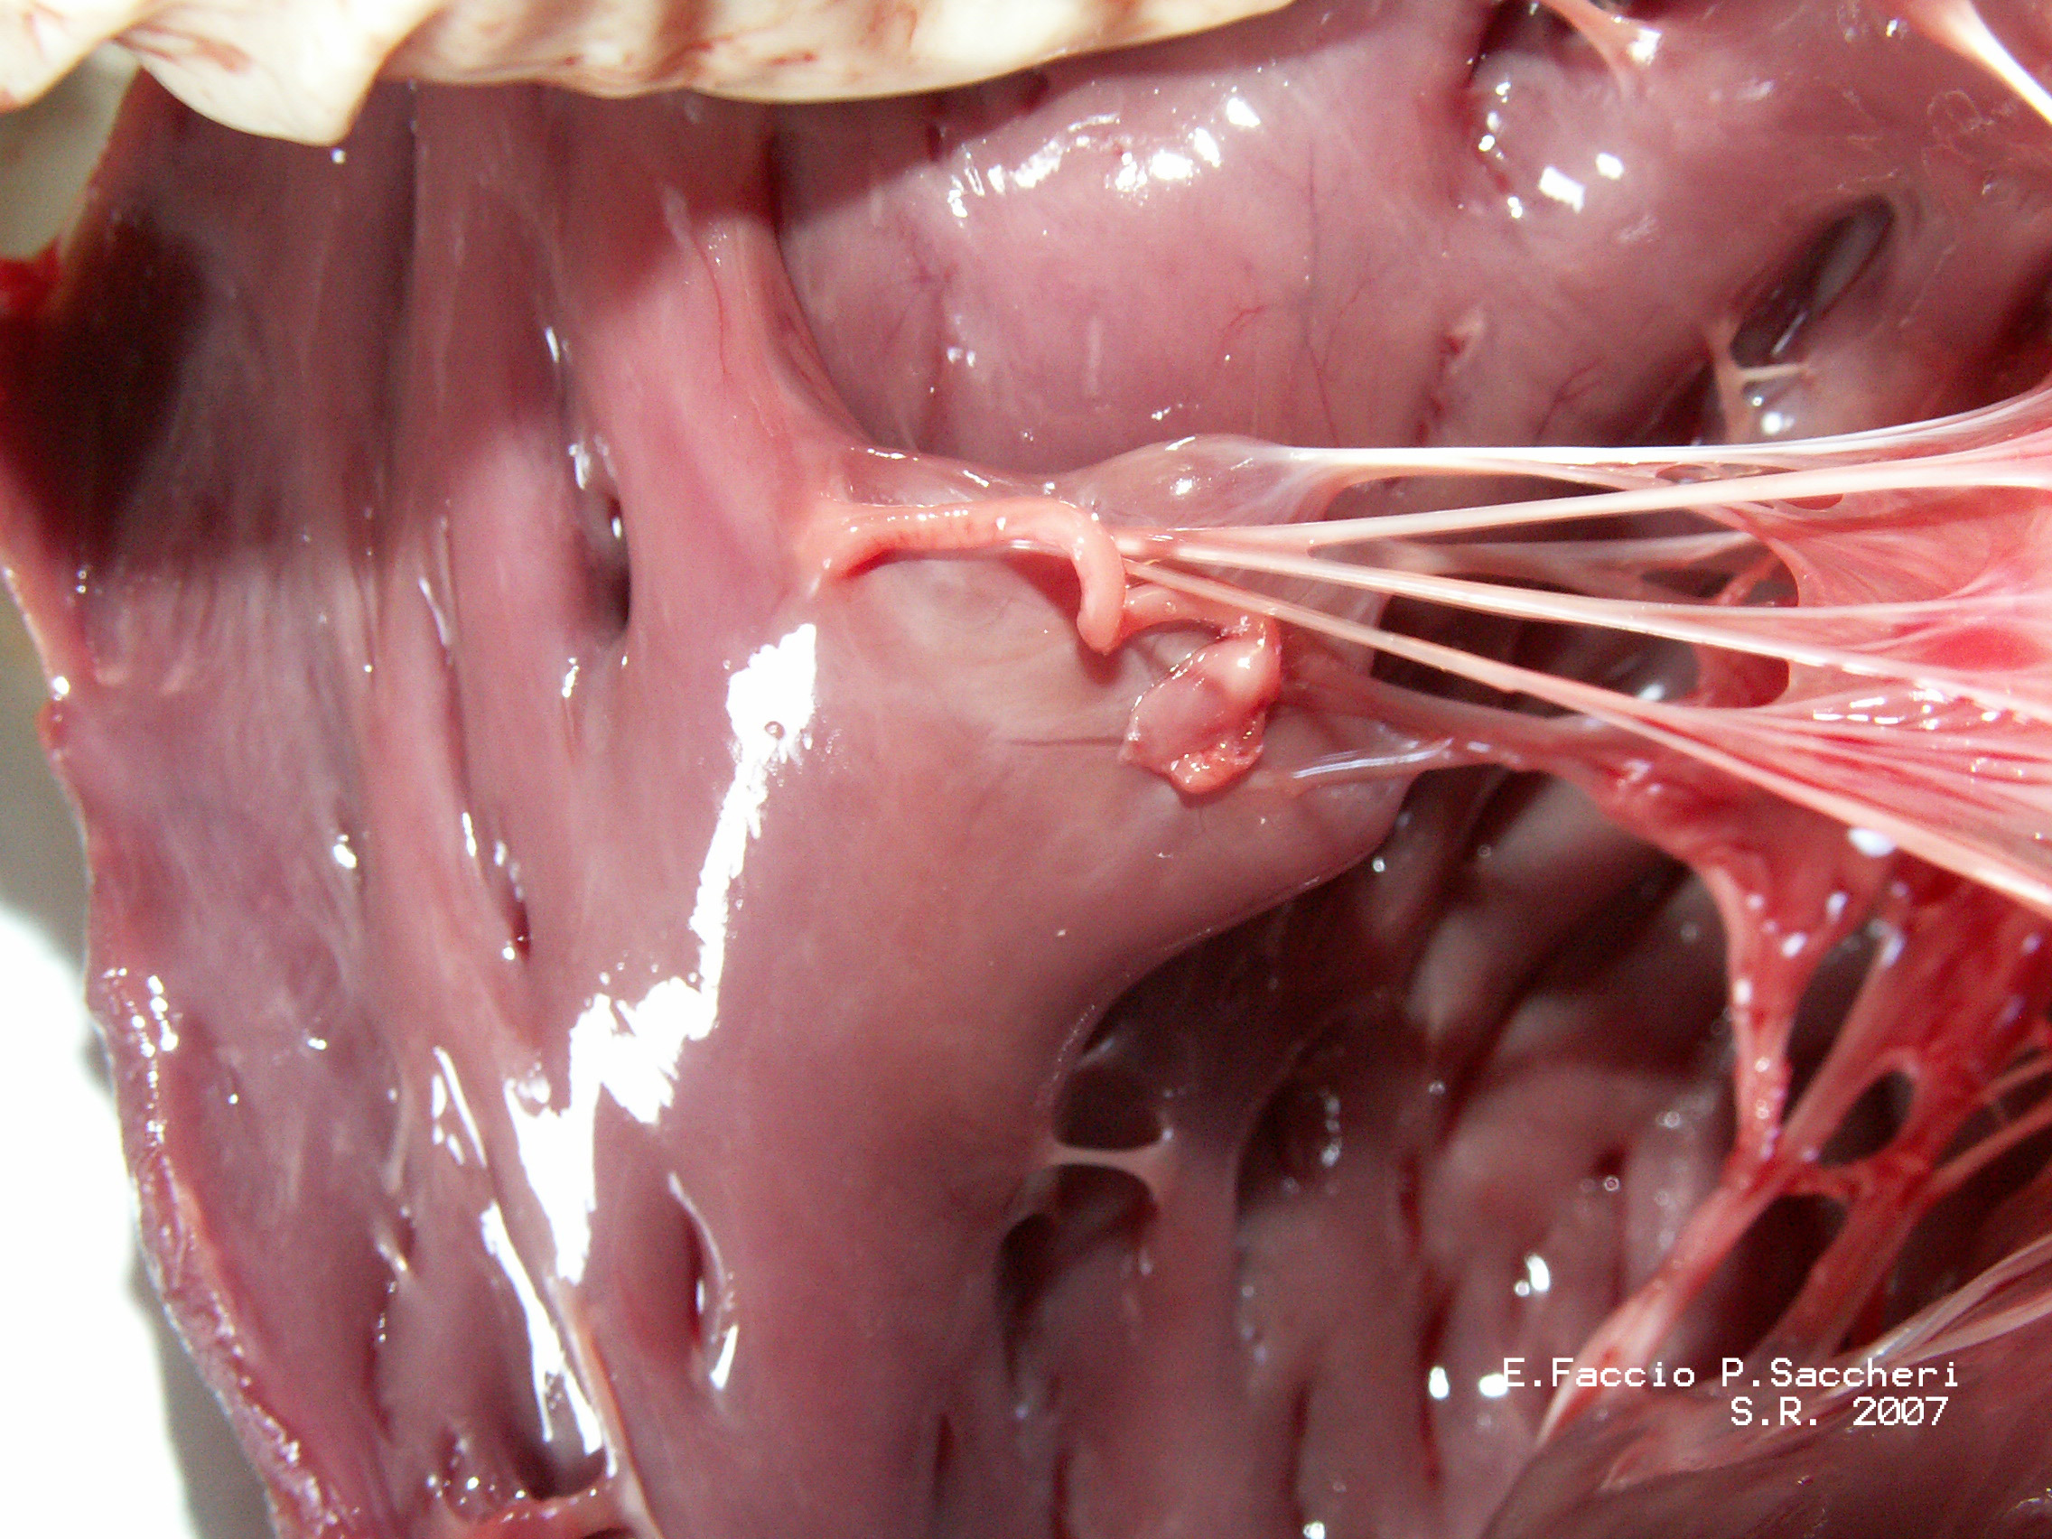
papillary muscle
one of the small muscular columns attached at one end to the chordae tendineae and at the other to the wall of the ventricle and that maintain tension on the chordae tendineae as the ventricle contracts

Slide 9
What structure?

Slide 10
Blood flow through the heart

Slide 11
Notes:
Teacher notes
In ‘Slide Show’ mode, click the name of a section to jump straight to that slide.

Slide 12
The cardiac cycle
Notes:
Teacher notes
The contraction of the atria only accounts for about 30% of the ventricular volume.
For a fraction of a second as the ventricles start to contract, all valves in the heart are closed.

Slide 13
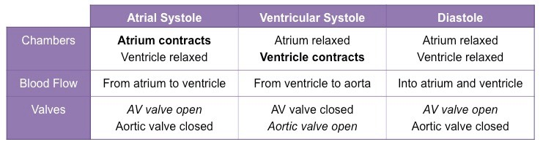

Slide 14
Interactive heart

Slide 15
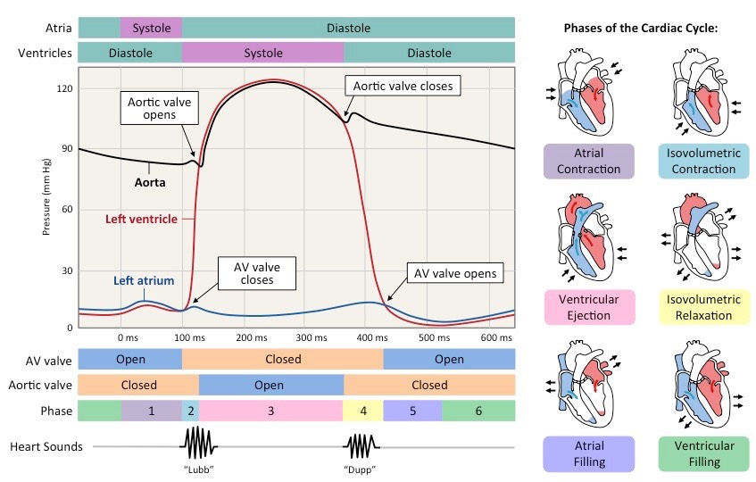

Slide 16
Pacemaker cells of the heart
The heart can beat without any input from the nervous system as longs as its cells stay alive. This is due to myogenic contraction.肌源性收缩
Muscle cells (myocytes) in the heart have a slight electrical charge across their membrane. They are polarized. When the charge is reversed, they are said to be depolarized and this causes them to contract.
Depolarization is initiated in a region of the heart called the sinoatrial node (SAN) – also known as the pacemaker – which is in the wall of the right atrium.

Slide 17
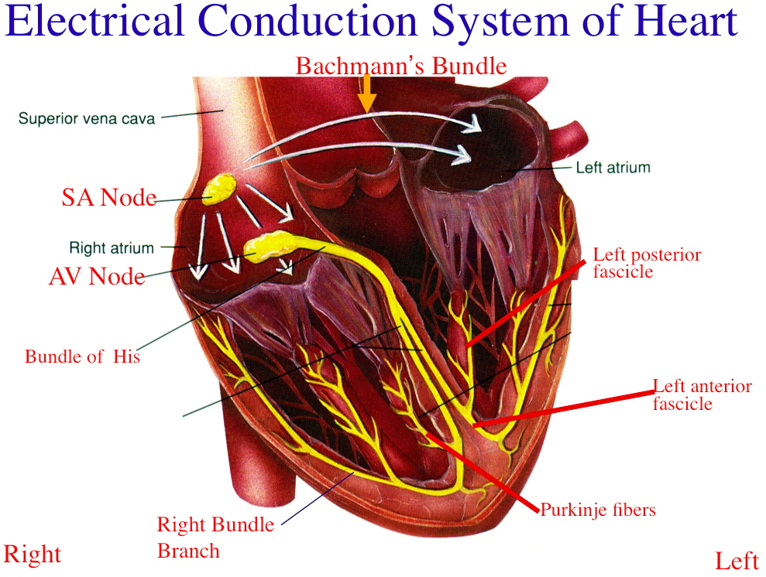
Book2 192
Notes:
https://www.differencebetween.com/difference-between-bundle-of-his-and-purkinje-fibres/

Slide 18
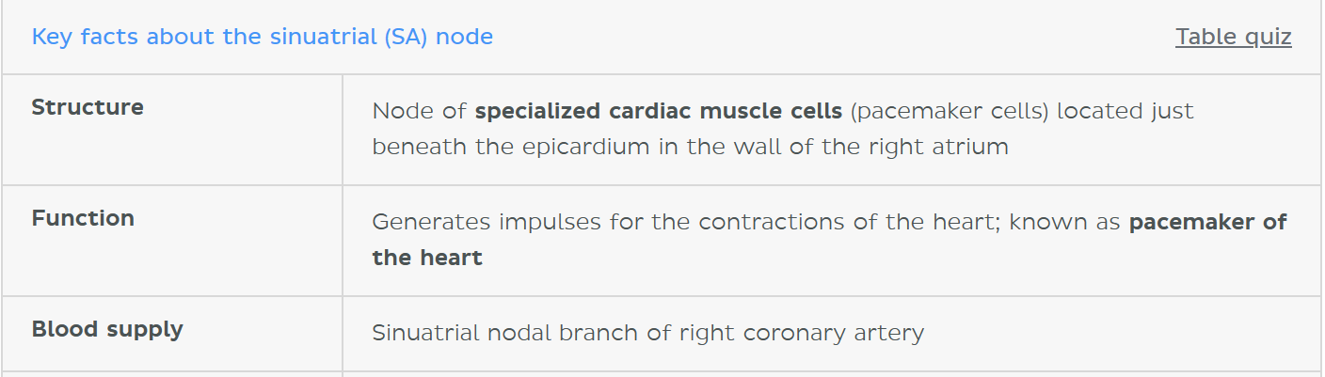
SA
It is known as the atrioventricular node (AV node) and is often called the secondary pacemaker of the heart,it functions as a conduit管道 of electrical activity from the SA node to the ventricles of the heart

Slide 19
Myogenic stimulation of the heart

Slide 20
Interactive heart

Slide 21
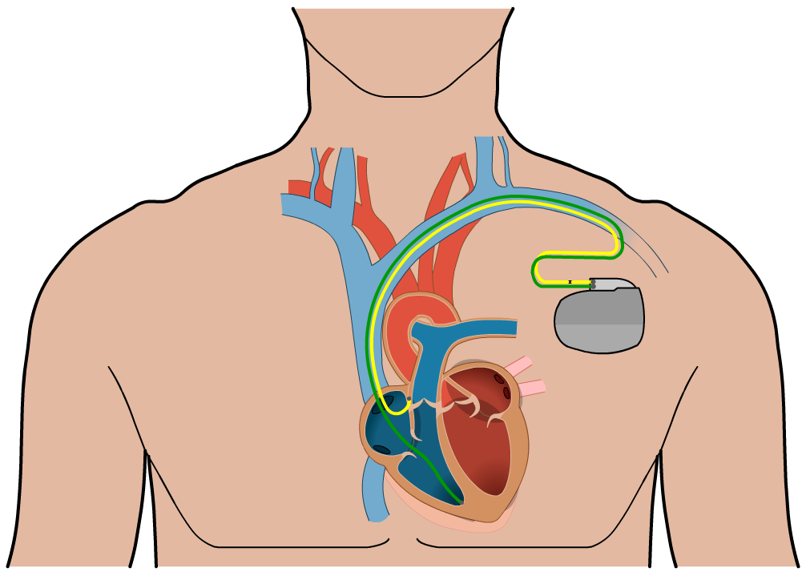
Artificial pacemakers
Artificial pacemakers are devices implanted in people whose heart’s electrical conduction system is not working properly.
Problems include the SAN not firing, and the blockage or disruption of impulses between the SAN and AVN, or in the bundle of His.
Pacemakers monitor the heart’s electrical activity and stimulate the ventricles or atria to contract when necessary. Impulses are transmitted down electrodes implanted in the muscular walls.
Notes:
Teacher notes
Pacemakers may be temporary (in which case the main pacemaker unit is usually external) or permanent.
Permanent pacemakers are commonly implanted beneath subcutaneous fat in the chest. The electrodes are inserted into a vein and passed through to be attached into the appropriate chamber(s) of the heart.

Slide 22
The cardiac cycle

Slide 23
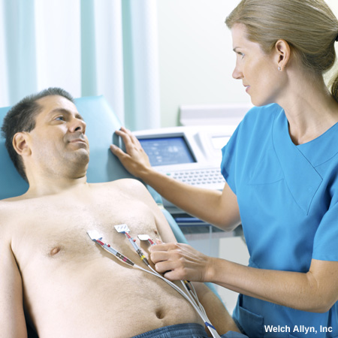
What are electrocardiograms?
The electrical activity of the heart can be monitored by an electrocardiograph.
Several electrodes are attached to specific places on a person’s chest and limbs. These detect changes in polarization in the heart by measuring current at the skin surface.
The leads are connected to a machine that draws an electrocardiogram (ECG).
Notes:
Photo credit: © Welch Allyn, Inc. All Rights Reserved
Teacher notes
A 12-lead ECG is the most common ECG performed, although only 10 electrodes are attached to a patient – one on each limb by the wrist/ankle, and six at various points on the chest.

Slide 24
Components of an ECG trace

Slide 25
the charge is measured at -70 mV, the value described as the resting membrane potential.（heart：-90mV）
Resting membrane potential describes the steady state of the cell, which is a dynamic process that is balanced by ion leakage and ion pumping.
Depolarization：Na+ ions will rush into the cell， the sodium cation entering the cell will cause it to become less negative.

Slide 26
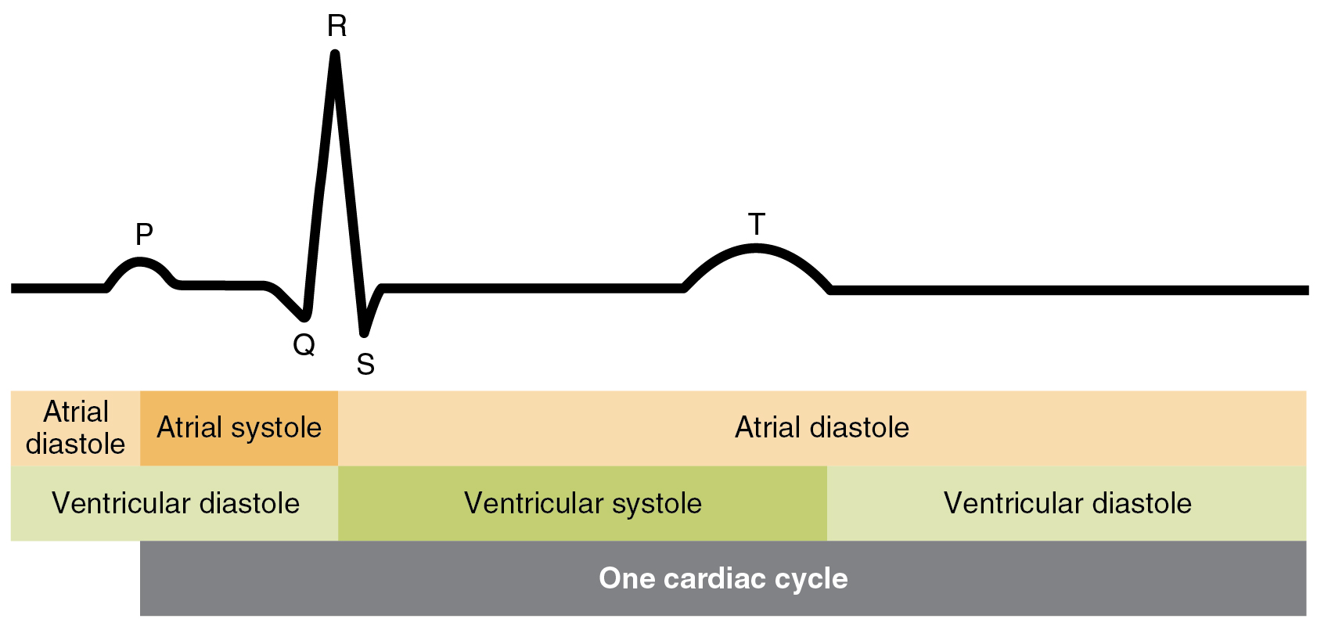
Repolarization：As K+ starts to leave the cell, taking a positive charge with it, the membrane potential begins to move back toward its resting voltage.
depolarization of the heart cells leads to contraction, and repolarization leads to relaxation
book2 194

Slide 27
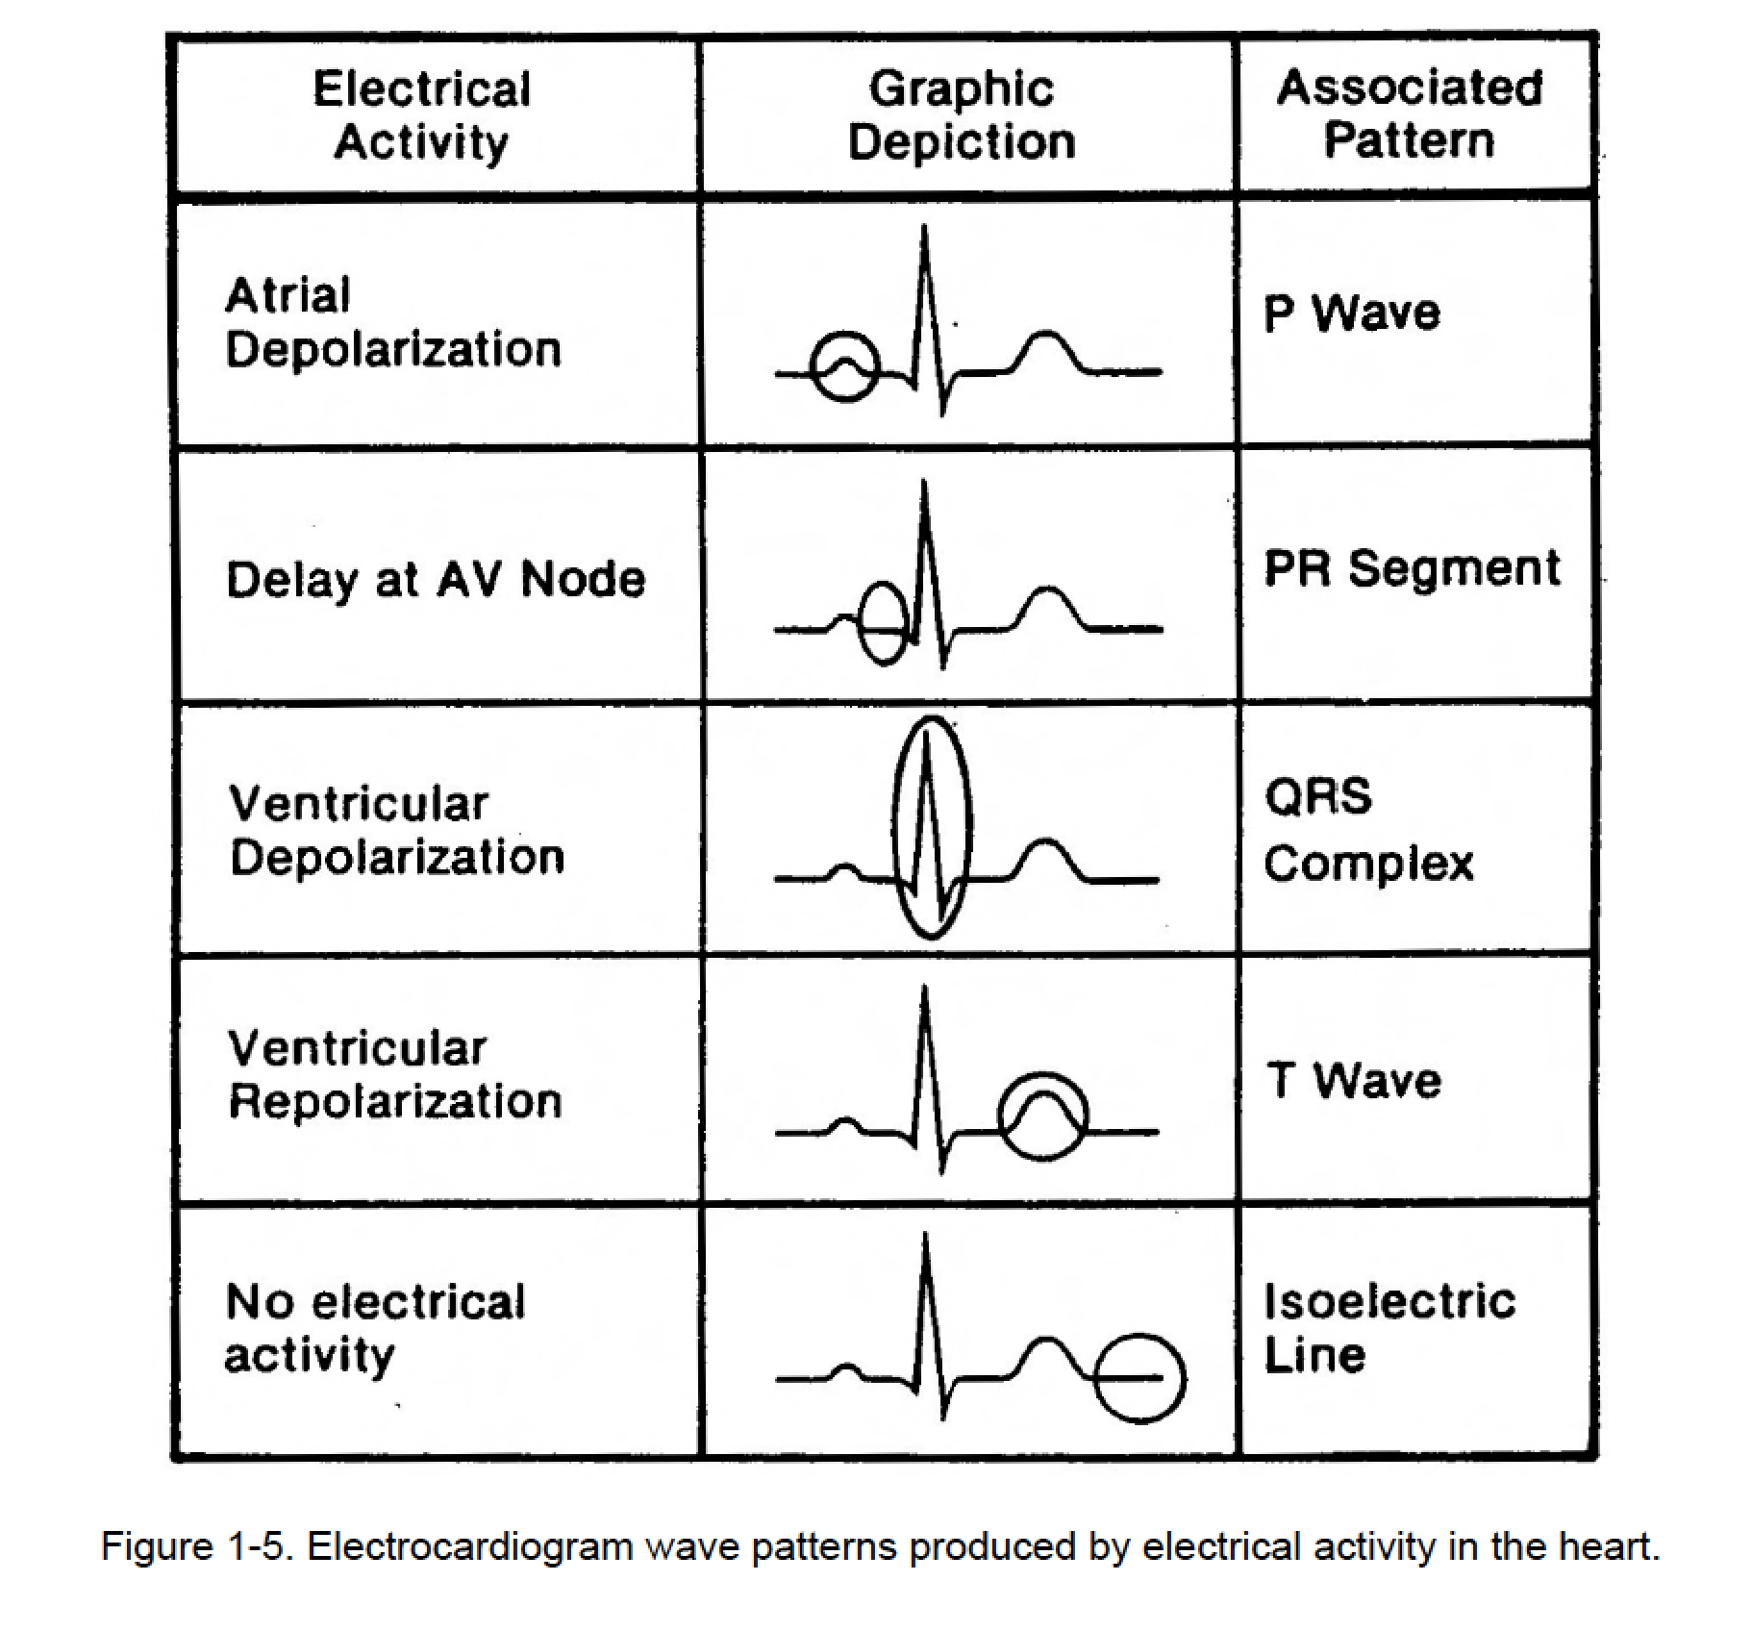

Slide 28
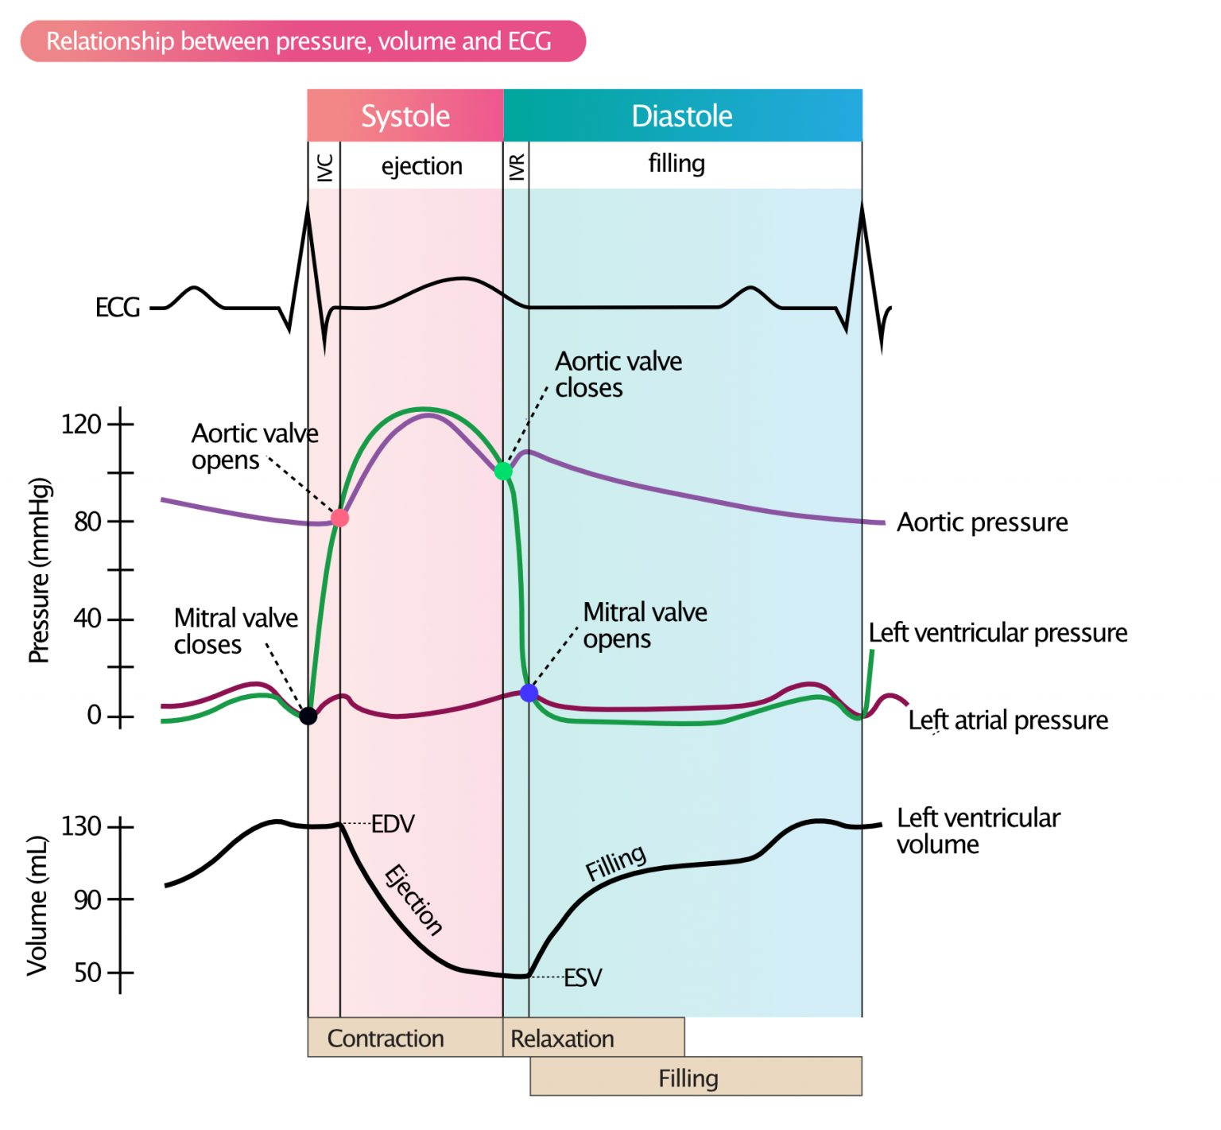

Slide 29
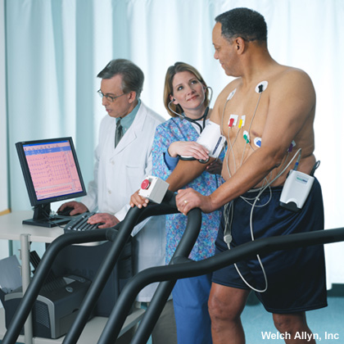
ECG in diagnosis
ECGs are used to diagnose problems with the heart, as variations in different components of the trace can indicate a disease or other abnormality.
An ECG may be taken while the patient is relaxed or it may be taken before, during and after exercise.
This is called a ‘stress test’ and usually involves the patient exercising on a treadmill while attached to an ECG machine.

Slide 30
Abnormal ECGs

Slide 31
Notes:
Teacher notes
In ‘Slide Show’ mode, click the name of a section to jump straight to that slide.

Slide 32
Glossary

Slide 33
What’s the keyword?

Slide 34
Multiple-choice quiz

